Slide 1
NNMF

Slide 2
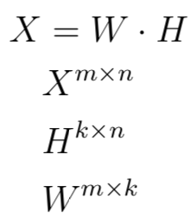
Non-Negative Matrix Factorization
Assumption
values in dataset are non-negative (>=0)

Slide 3
Non-Negative Matrix Factorization
Assumption
Approach
Decompose dataset into two matrices that, when multiplied, approximate our original dataset

Slide 4
Non-Negative Matrix Factorization
Assumption
Approach
W is our reduced matrix
H are our components for transformation

Slide 5
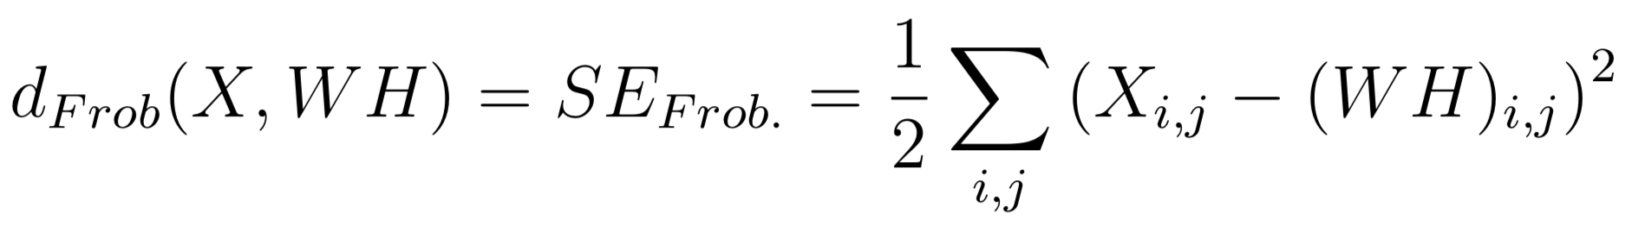
Optimization
Minimize distances between original and deconstructed matrix
Distance metric/loss function is SE for matrices
Aka Frobenius norm

Slide 6
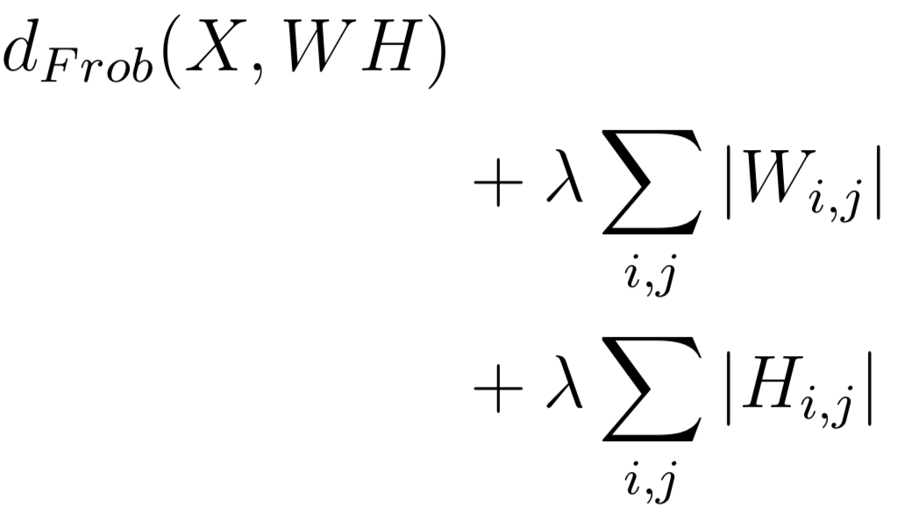
Regularization
L1

Slide 7
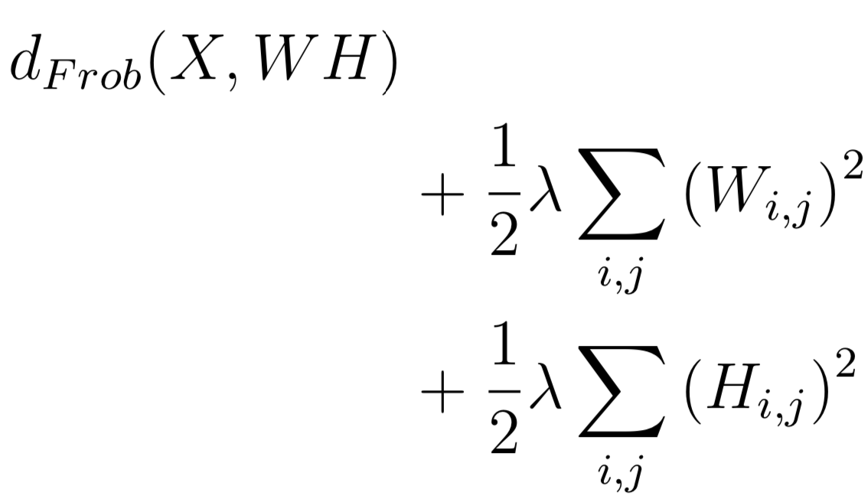
Regularization
L1
L2

Slide 8
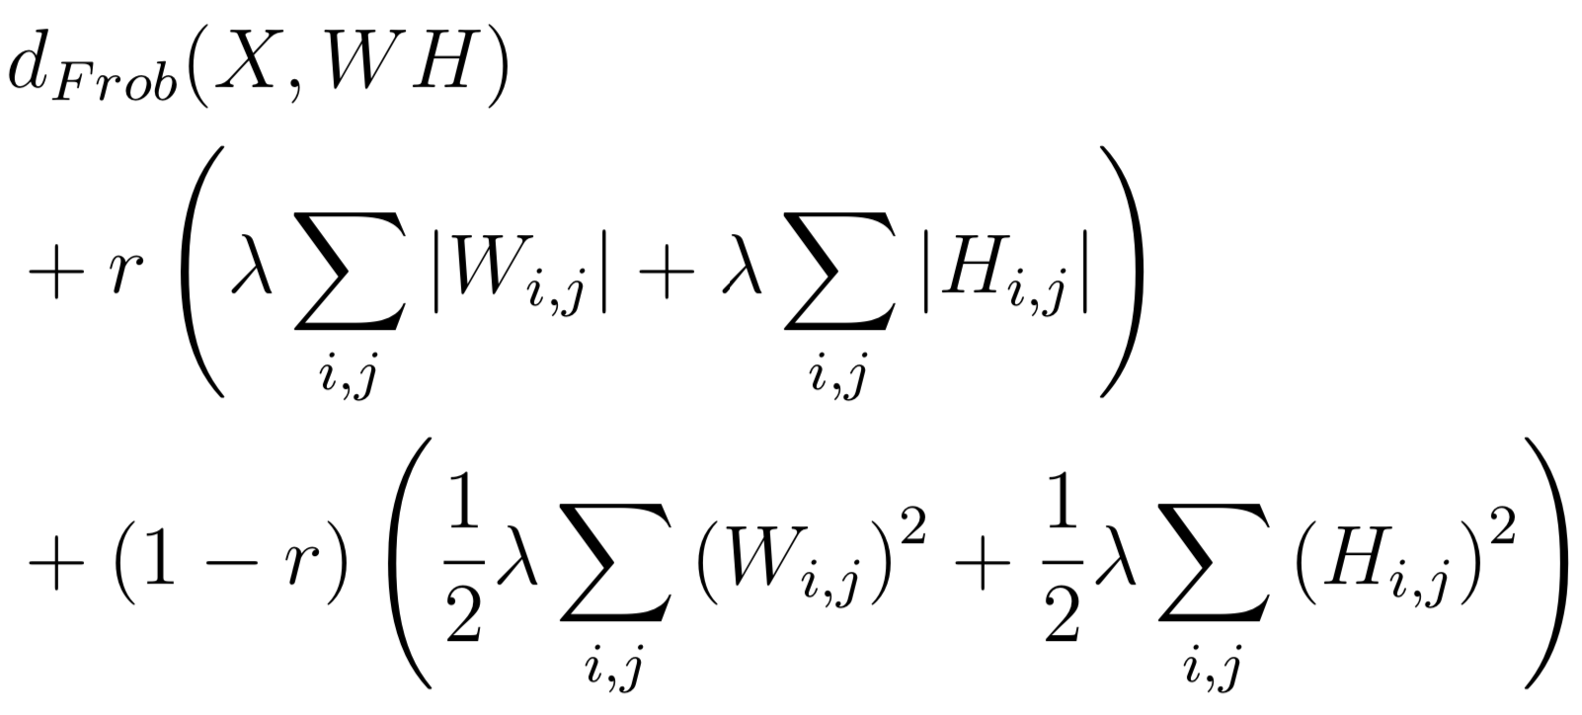
Regularization
L1
L2
Elasticnet
r - L1 ratio
Sklearn actually also allows selection if regularization should be applied to H, W, or both

